Slide 1
PSCS_452 - Freelancing Platform
CSE7101- Capstone Project
Review-2
Batch Number: COM_62
Under the Supervision of,
Dr. Ruhin Kouser R
Assistant Professor – Senior Scale
School of Computer Science and Engineering
Presidency University
Roll Number | Student Name
20221COM0002 | Prithvi Krishnan M
Name of the Program: B.Tech – Computer Engineering (Artificial Intelligence & Machine Learning)
Name of the HoD: Dr. Pallavi R
Name of the Program Project Coordinator: Ms. Benitha Christinal J
Name of the School Project Coordinators: Dr. Sampath A K , Dr. Geetha A

Slide 2
Content
Abstract
Literature Survey
Objectives
Existing System & Drawbacks
Proposed Model & Feasibility Study
Architecture Diagram
Modules
Hardware & Software Details
Timeline of the Project
References

Slide 3
Abstract
The proposed system is an AI-powered freelancing platform that is made for Indian market.
It solves big problems that are common on other platforms, like a lack of trust, late payments, high fees, and bad UPI support.
The project combines AI-based job-talent matching with a fake escrow payment system that uses UPI logic to make sure that clients and freelancers can work together safely and openly.
This phase of implementation is all about integrating modules, building the backend, and testing functional features.

Slide 4
Literature Survey
Arefin & Hossain (2019): Used client feedback classification + association rule mining for job recommendations; lacks AI-driven semantic matching and local payment focus.
Rezaei & Lin (2020): Applied deep-learning-based semantic job recommendation; doesn’t address escrow or regional payment integration.
Zhang et al. (2007): Modelled escrow frameworks to improve online trust; focused on auctions, not freelancing ecosystems.
AI-Powered Freelancing (2025): Proposed an AI framework for smarter gig allocation; lacks implementation for UPI or India-specific use.
Ertuğrul & Çelik (2025): Conducted a systematic review of job recommender systems; highlights lack of localized and context-aware solutions.
Mashayekhi et al. (2022): Surveyed e-recruitment recommendation systems; limited to corporate hiring, not freelance platforms.
Antony et al. (2006): Studied escrow adoption in e-commerce; lacks integration with AI or modern digital payment models.
Reddy et al. (2024): Designed decentralized escrow protocol for P2P payments; not adapted to freelance project workflows.
Azri (2025): Developed context-aware ML job recommender; doesn’t include trust or payment mechanisms.
Pavlou (2004): Analysed institution-based trust in online markets; no AI or regional adaptation to Indian freelancers.

Slide 5
Objectives
Set up a full-fledged freelancing marketplace with an escrow simulation.
Use data from users to create a job-talent matching engine powered by AI.
Allow safe UPI-based mock transactions between clients and freelancers.
Make dashboards for clients and freelancers based on their roles.
Use open-source tools to deploy on Render Cloud / MongoDB Atlas.

Slide 6
Existing Systems and Drawbacks
UpWork offers global reach with minimum localization
Fiverr offers quick gigs but does not provide comprehensive project management.
Freelancer.com features the bidding methodology, hefty fees and limited payment methods for Indians

Slide 7
Proposed Model and Feasibility Study
Proposed Model:
  Clients post projects → Freelancers bid → AI recommends best matches → Escrow holds payment → Delivery & release.
  The escrow is simulated for academic demonstration without real money.
Feasibility Study:
  Technical: Uses MERN/Python stack with TensorFlow & MongoDB Atlas.
  Economic: Completely open-source + free-tier cloud hosting.
  Operational: Designed and implemented by a single developer (individual project)

Slide 8
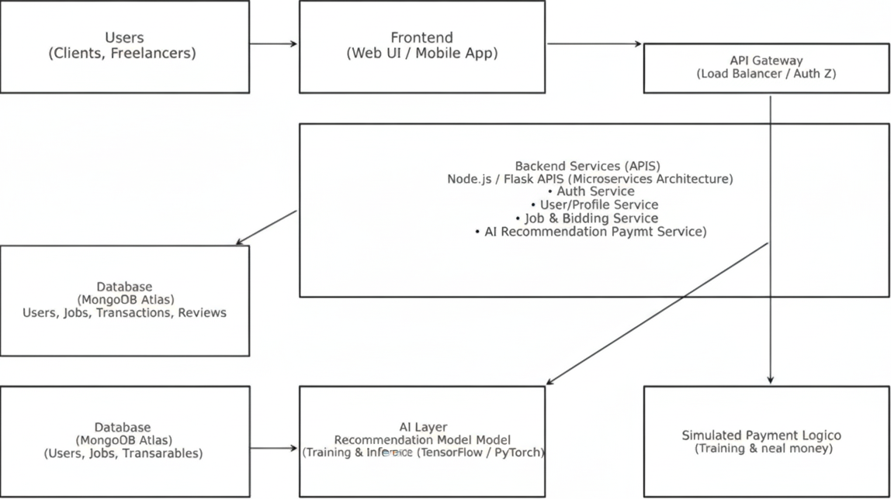
Architecture Diagram

Slide 9
Modules
Authentication Module – User login / registration.
Profile & Portfolio – Manage skills, uploads, and visibility.
Job Posting & Bidding – Clients post; freelancers apply.
AI Recommendation Engine – Suggests optimal matches.
Escrow Simulation – Securely holds & releases payments.
File Sharing & Chat Module – Streamlined communication.

Slide 10
Hardware and Software Requirements
Hardware Requirements:
  Mid-range system: Intel i5 / Ryzen 5 or higher
  8–16 GB RAM, SSD storage
  Integrated/dedicated GPU, Full HD display
  Standard peripherals and stable internet
Software Requirements:
  OS: Windows / Linux / macOS
  Development: Python / Java, VS Code, GitHub
  Database: MySQL / PostgreSQL / MongoDB
  Frameworks: React, Node.js, TensorFlow / PyTorch
  Tools: Office suite, browser, version control

Slide 11
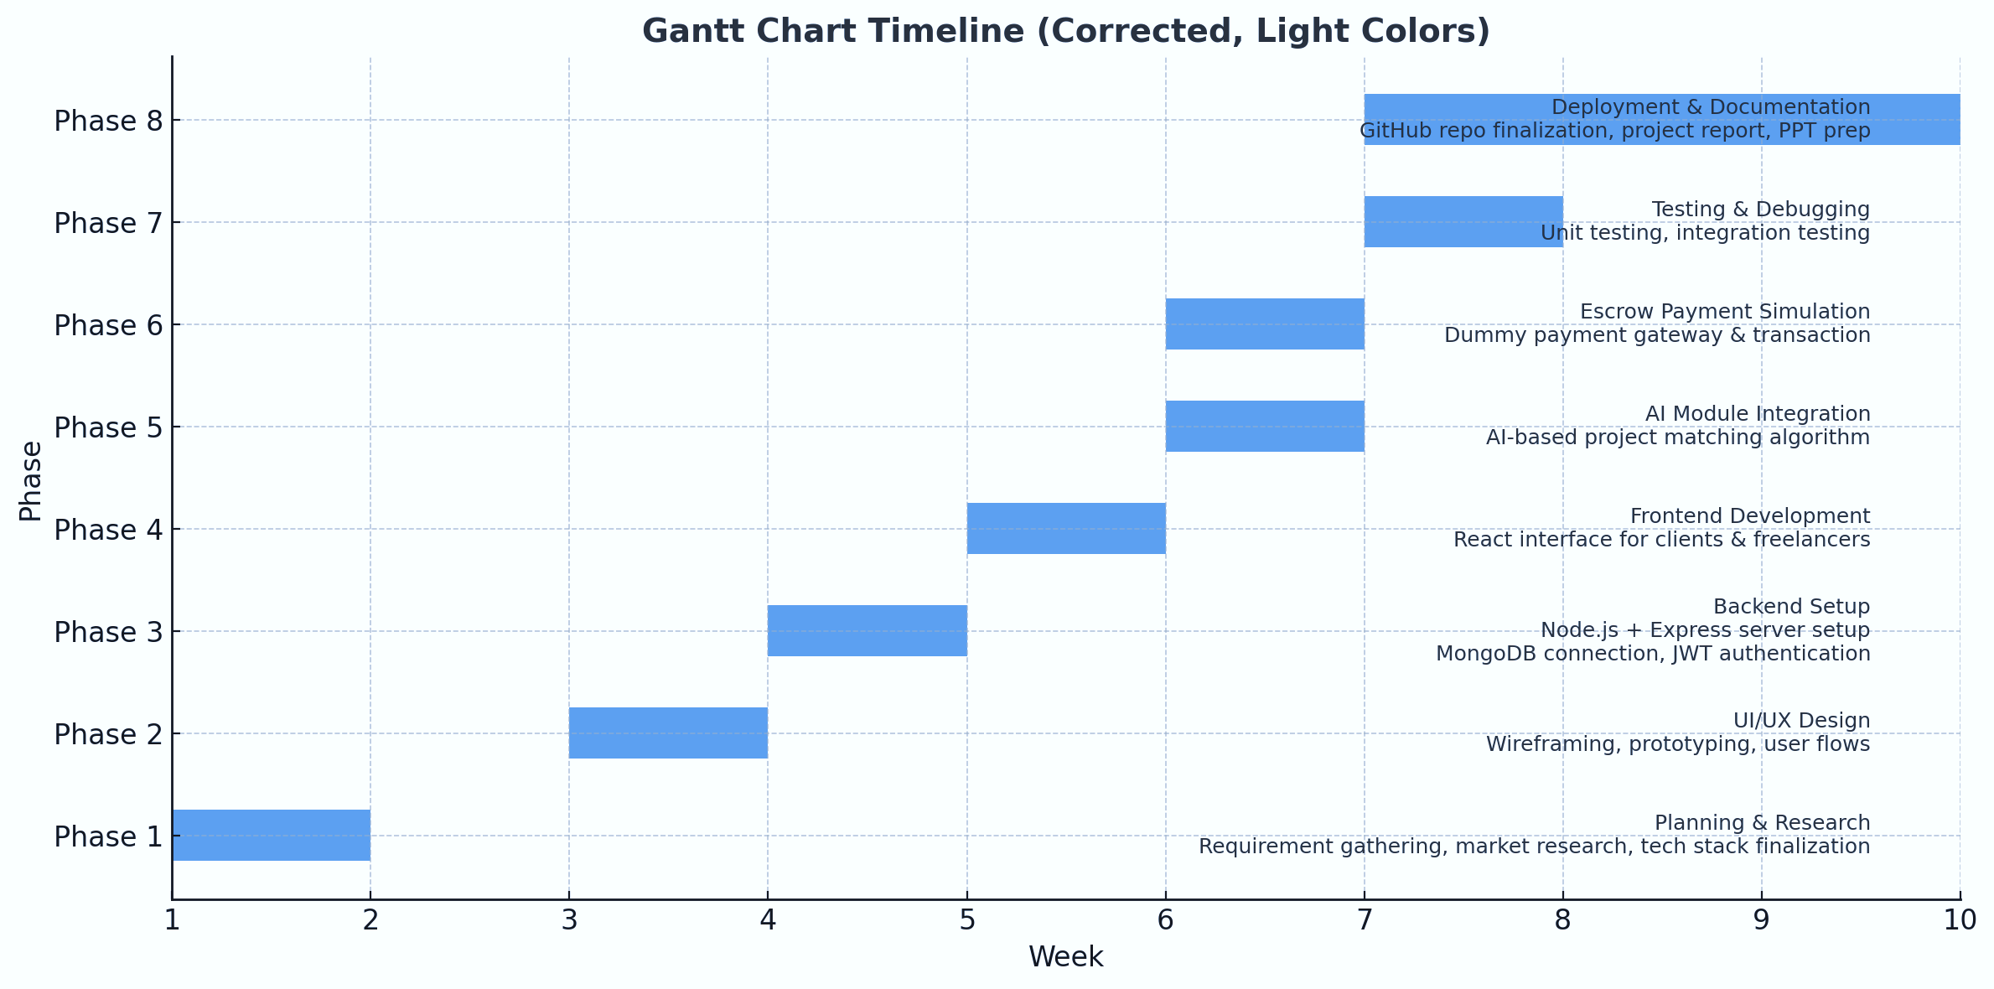
Project Timeline

Slide 12
References
[1] M. S. Arefin and M. S. Hossain, “Development of an intelligent job recommender system for freelancers using client’s feedback classification and association rule mining techniques,” in Proc. [Conference/Journal Name], Jun. 2019.
[2] A. Rezaei and Y. Lin, “A semantic job recommendation system based on deep learning,” IEEE Trans. Emerg. Topics Comput., vol. 8, no. 2, pp. 263–274, Apr.–Jun. 2020.
[3] AI-Powered Freelancing: A Design Framework for Smarter Job Allocation, OAIJSE, vol. 8, no. 3, 2025.
[4] H. Zhang, Z. Lin, and X. Hu, “The effectiveness of the escrow model: An experimental framework for dynamic online environments,” J. Org. Comput. Electron. Commerce, vol. 17, no. 2, pp. 1–25, 2007.

Slide 13


